Slide 1
Data Structure and Algorithm CSE-225
Dr. Mohammad Abu Yousuf
yousuf@juniv.edu

Slide 2
Quicksort

Slide 3
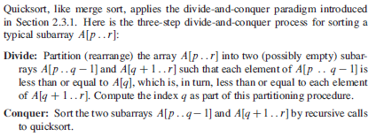

Slide 4
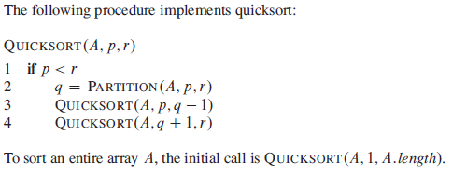
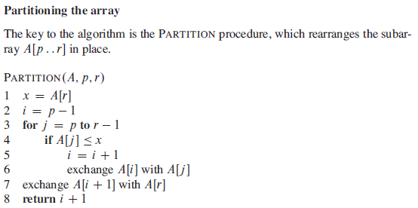

Slide 5
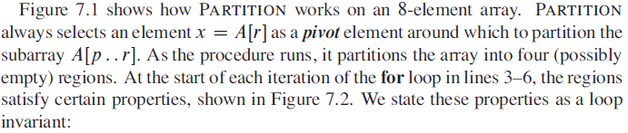
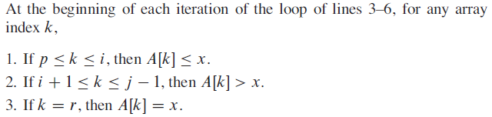

Slide 6
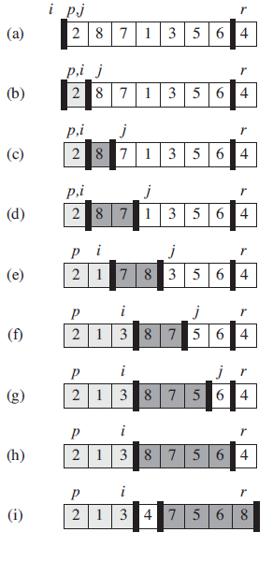
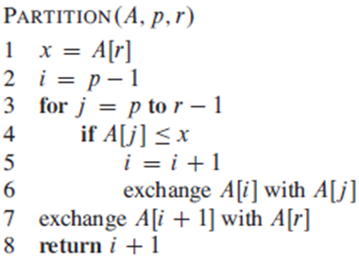

Slide 7
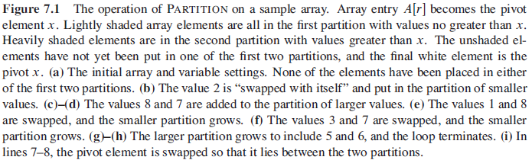
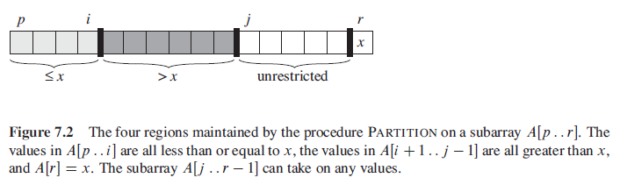

Slide 8
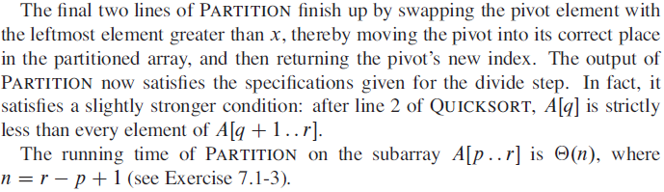
Running Time

Slide 9
Performance of quicksort
The running time of quicksort depends on whether the partitioning is balanced or unbalanced, which in turn depends on which elements are used for partitioning.
If the partitioning is balanced, the algorithm runs asymptotically as fast as merge sort.
If the partitioning is unbalanced, however, it can run asymptotically as slowly as insertion sort.
Here, we shall informally investigate how quicksort performs under the assumptions of balanced versus unbalanced partitioning.

Slide 10
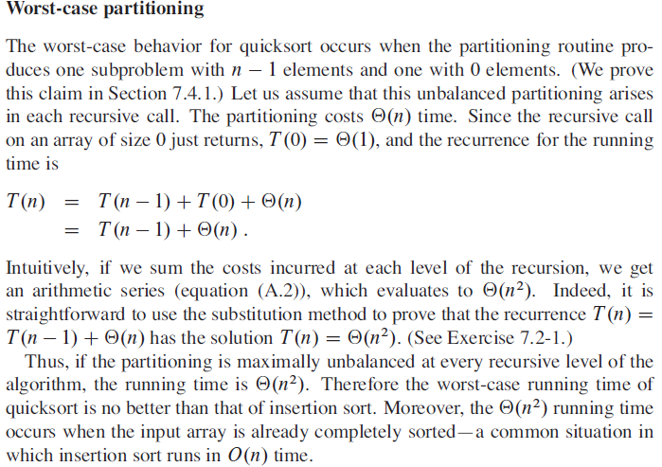

Slide 11
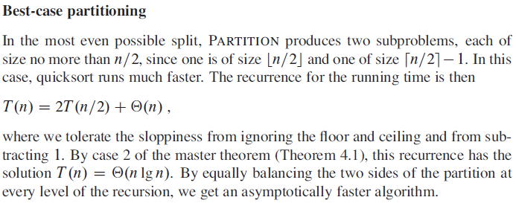

Slide 12
Heap Sort

Slide 13
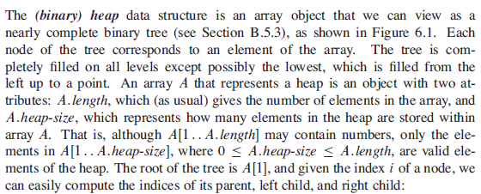
Heap

Slide 14
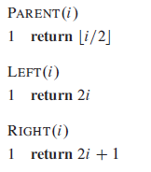
Heap

Slide 15
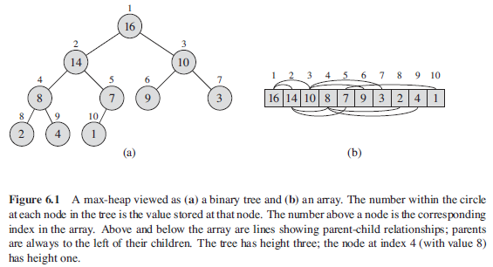
Heap

Slide 16

Heap
There are two kinds of binary heaps: max-heaps and min-heaps. In both kinds, the values in the nodes satisfy a heap property, the specifics of which depend on the kind of heap.
In a max-heap, the max-heap property is that for every node i other than the root,
That is, the value of a node is at most the value of its parent. Thus, the largest element in a max-heap is stored at the root, and the subtree rooted at a node contains values no larger than that contained at the node itself.

Slide 17

Heap
A min-heap is organized in the opposite way; the min-heap property is that for every node i other than the root,
The smallest element in a min-heap is at the root.
For the heap-sort algorithm, we use max-heaps. Min-heaps commonly implement priority queues.
We shall be precise in specifying whether we need a max-heap or a min-heap for any particular application, and when properties apply to either max-heaps or min-heaps, we just use the term “heap.”

Slide 18
Heap
Viewing a heap as a tree, we define the height of a node in a heap to be the number of edges on the longest simple downward path from the node to a leaf, and we define the height of the heap to be the height of its root.

Slide 19
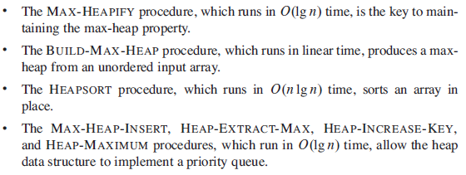
Heap

Slide 20
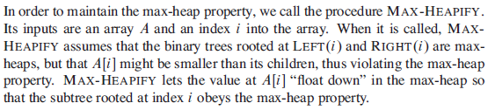
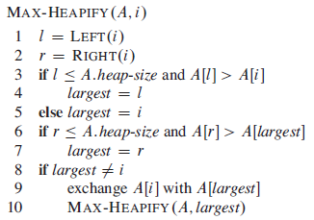
Maintaining the heap property

Slide 21
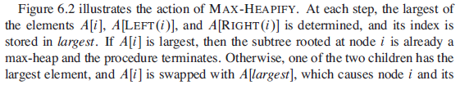

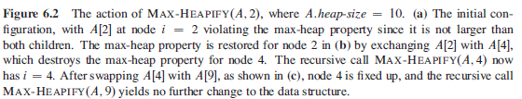

Slide 22
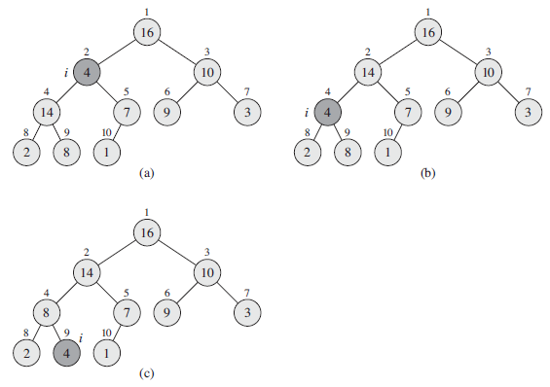
Fig: 6.2

Slide 23
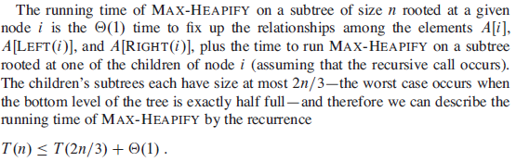
Running Time

Slide 24


Building a heap

Slide 25
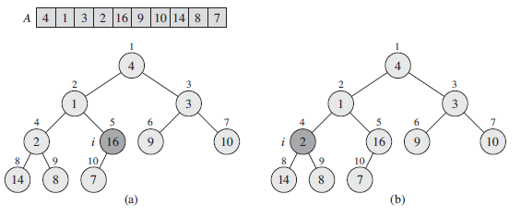
Example: Build Heap

Slide 26
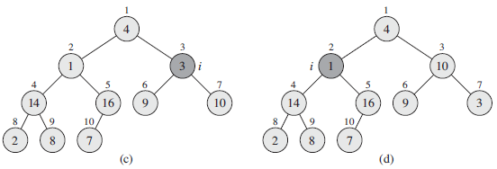

Slide 27
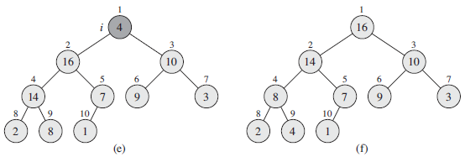
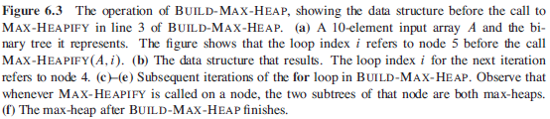

Slide 28

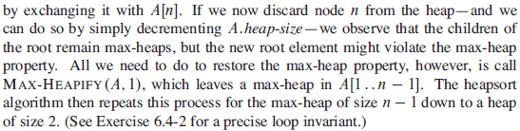
The heapsort algorithm

Slide 29
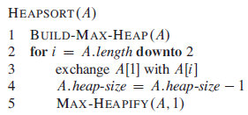

Slide 30
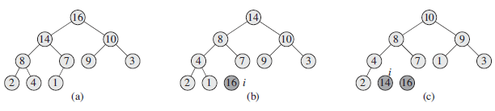
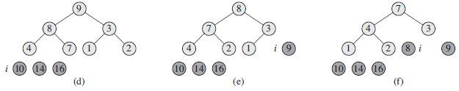
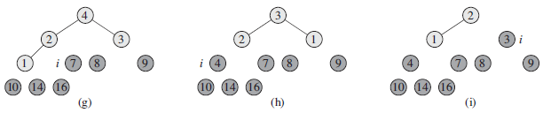

Slide 31

Running Time

Slide 32
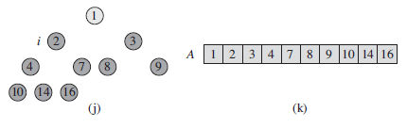


Slide 33
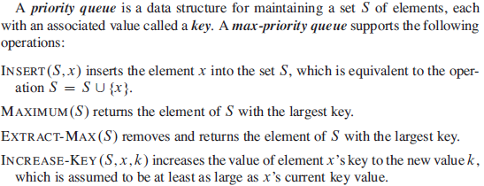
Priority queues

Slide 34
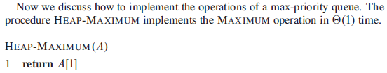
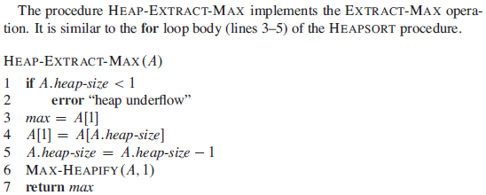

Slide 35
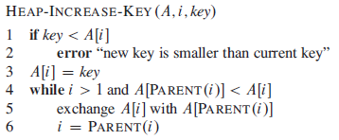


Slide 36
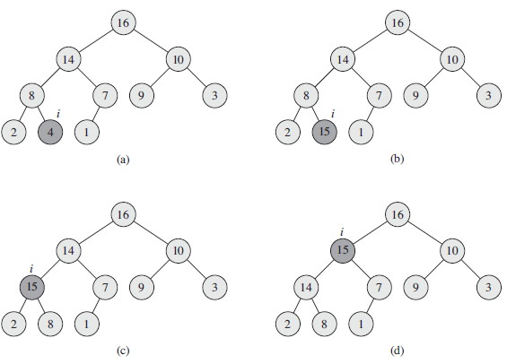


Slide 37
Thank You

